Slide 1

Detyre Permbledhese
workshop.css
Lenda:TIK
Klasa:Xc
[Krijimi I nje faqe WEB]
}
Programming Language

Slide 2
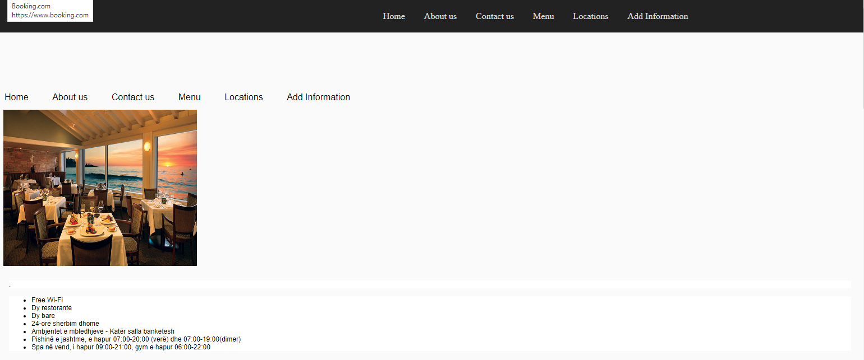
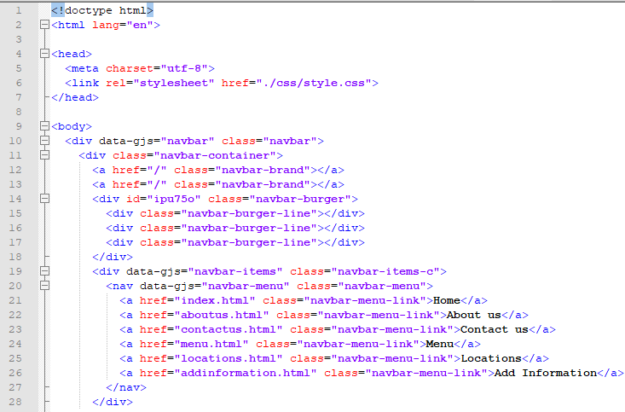
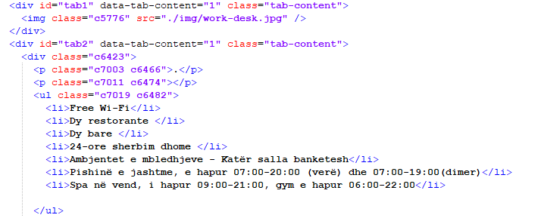
01
HOME (page)
forbeginners.html
workshop.css
}
Programming Language

Slide 3
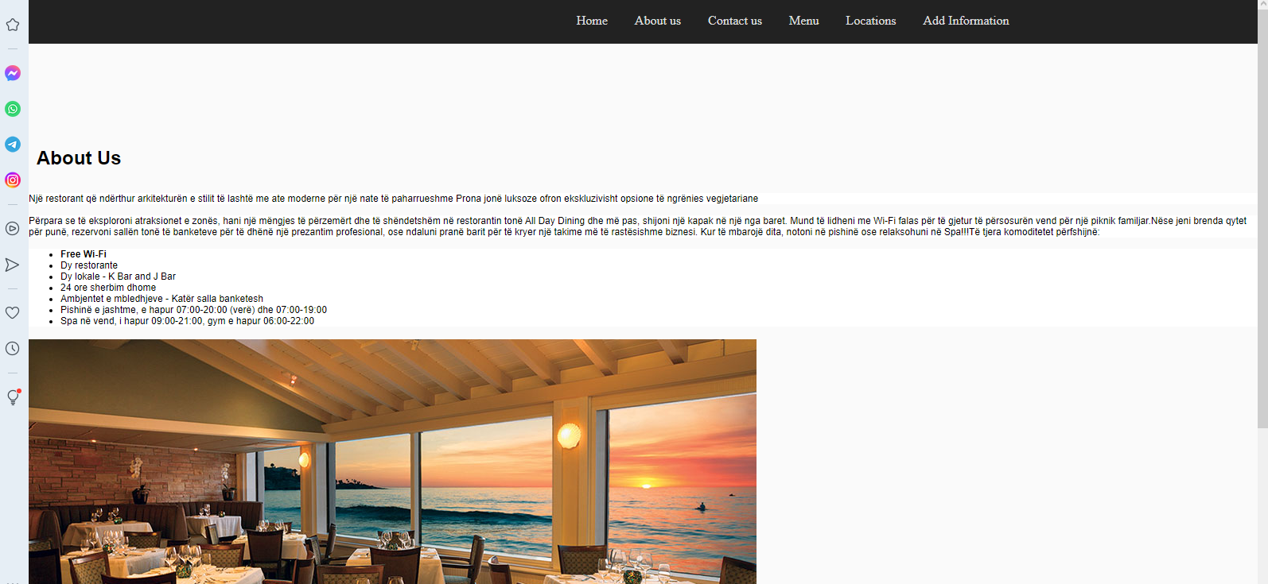
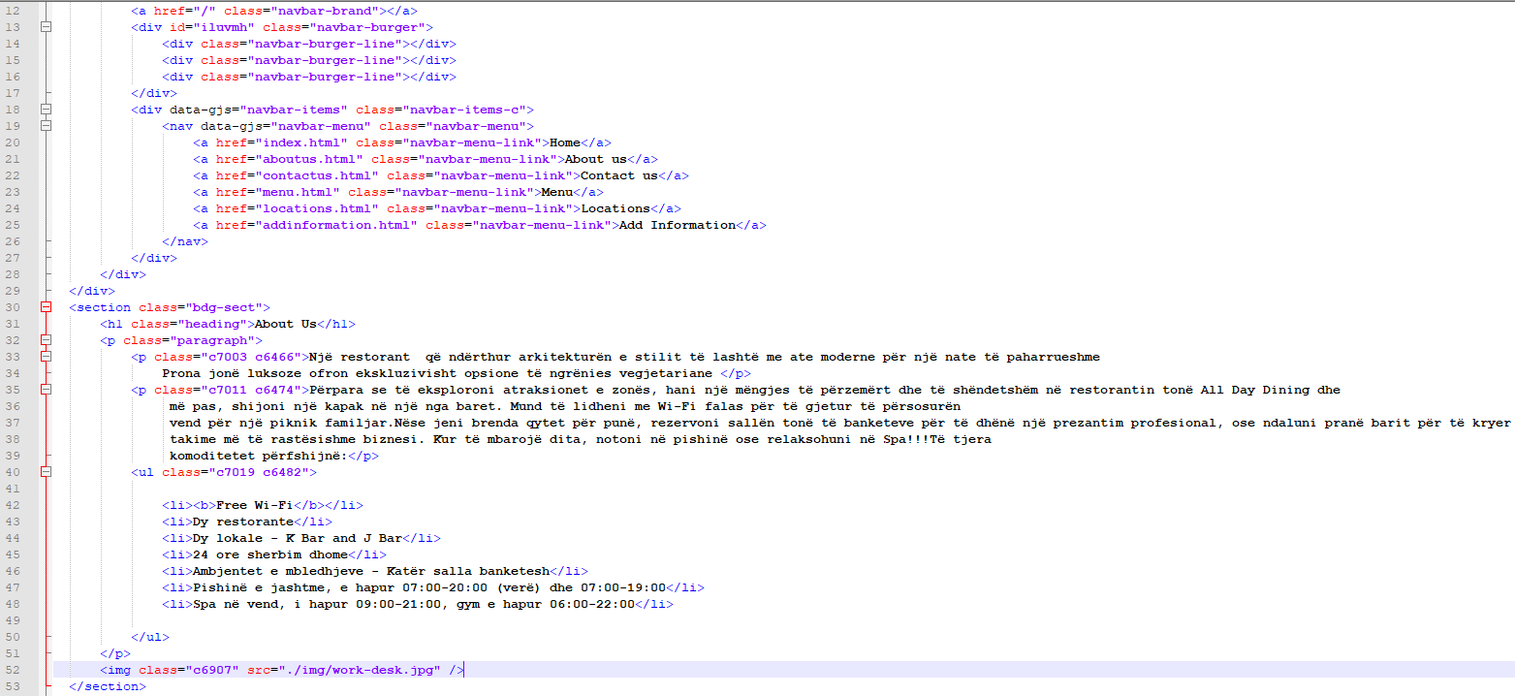
02
[ABOUT US (page)]
workshop.css
Programming Language

Slide 4
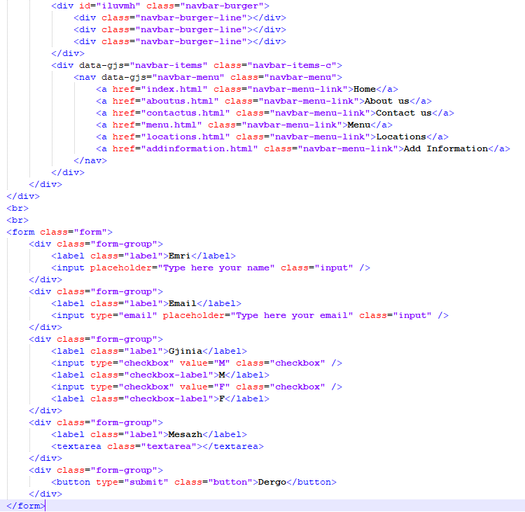
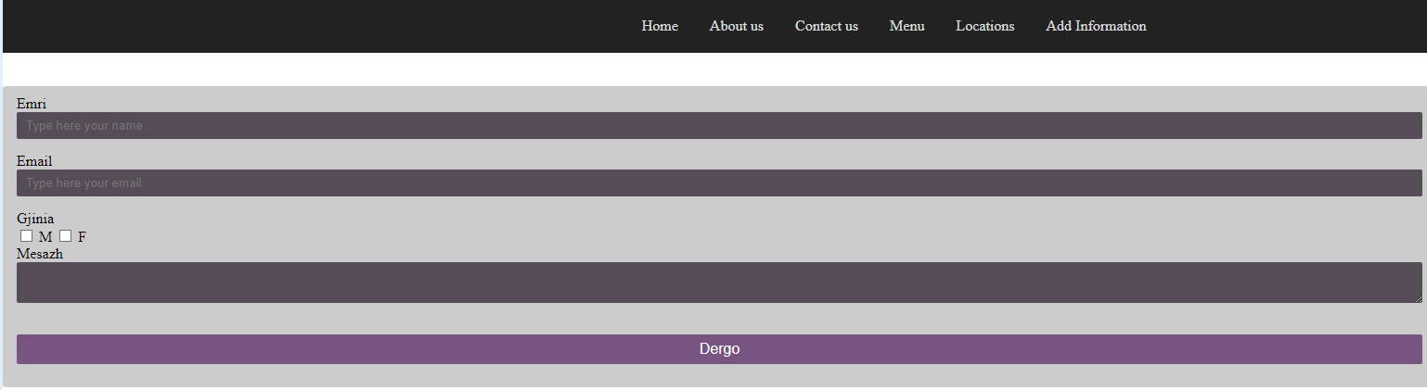
03
CONTACT US (page)

Slide 5
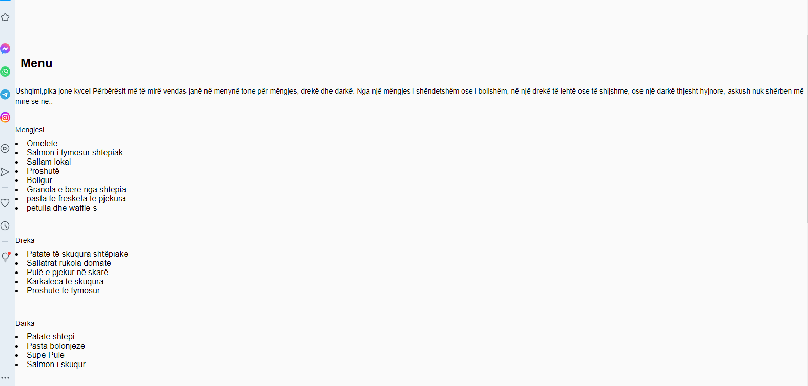
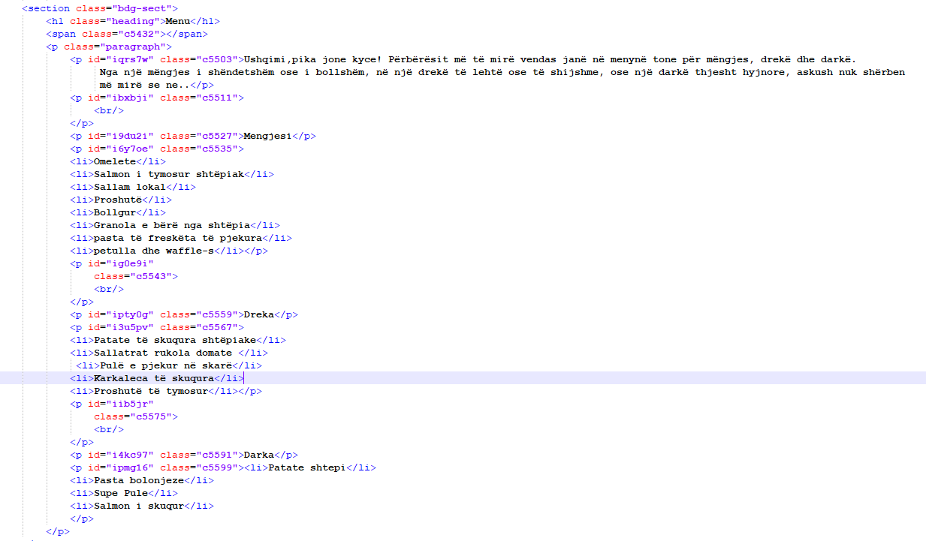
04
MENU (page)

Slide 6
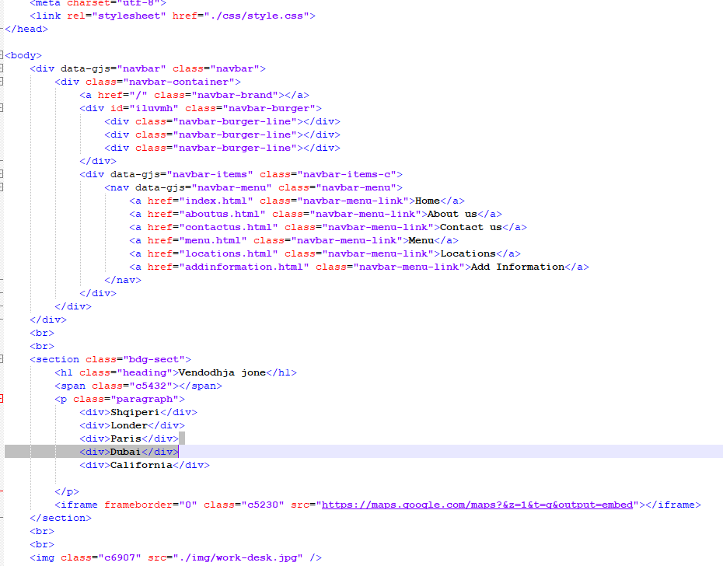
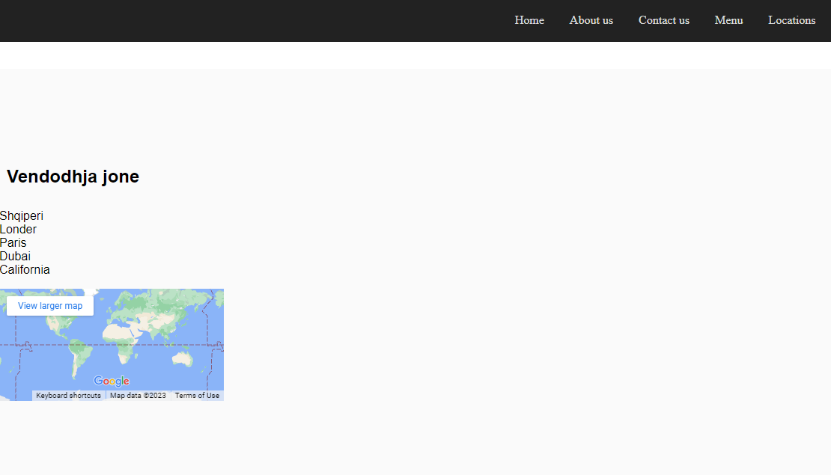
05
LOCATION (page)

Slide 7
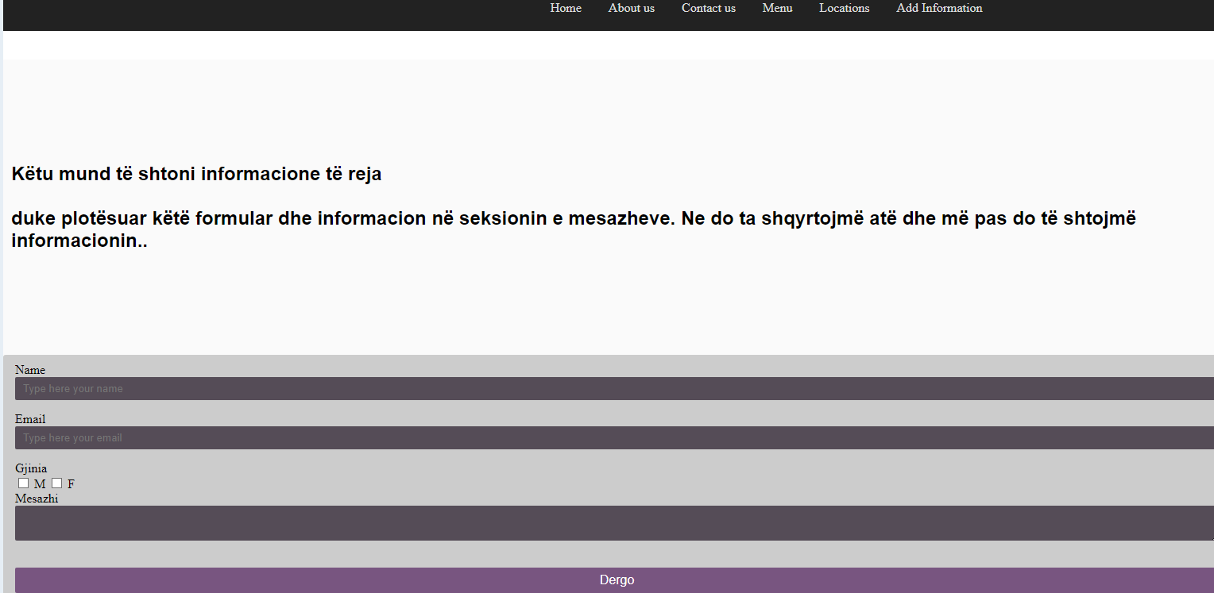
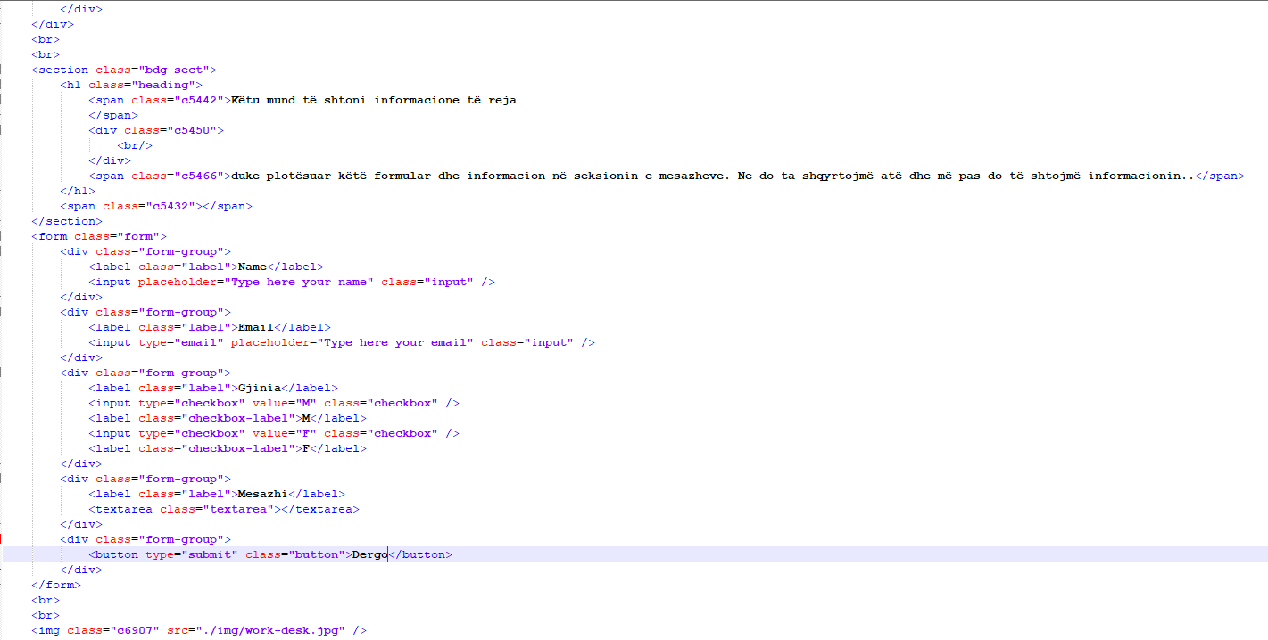
07
Add information (page)

